Slide 1
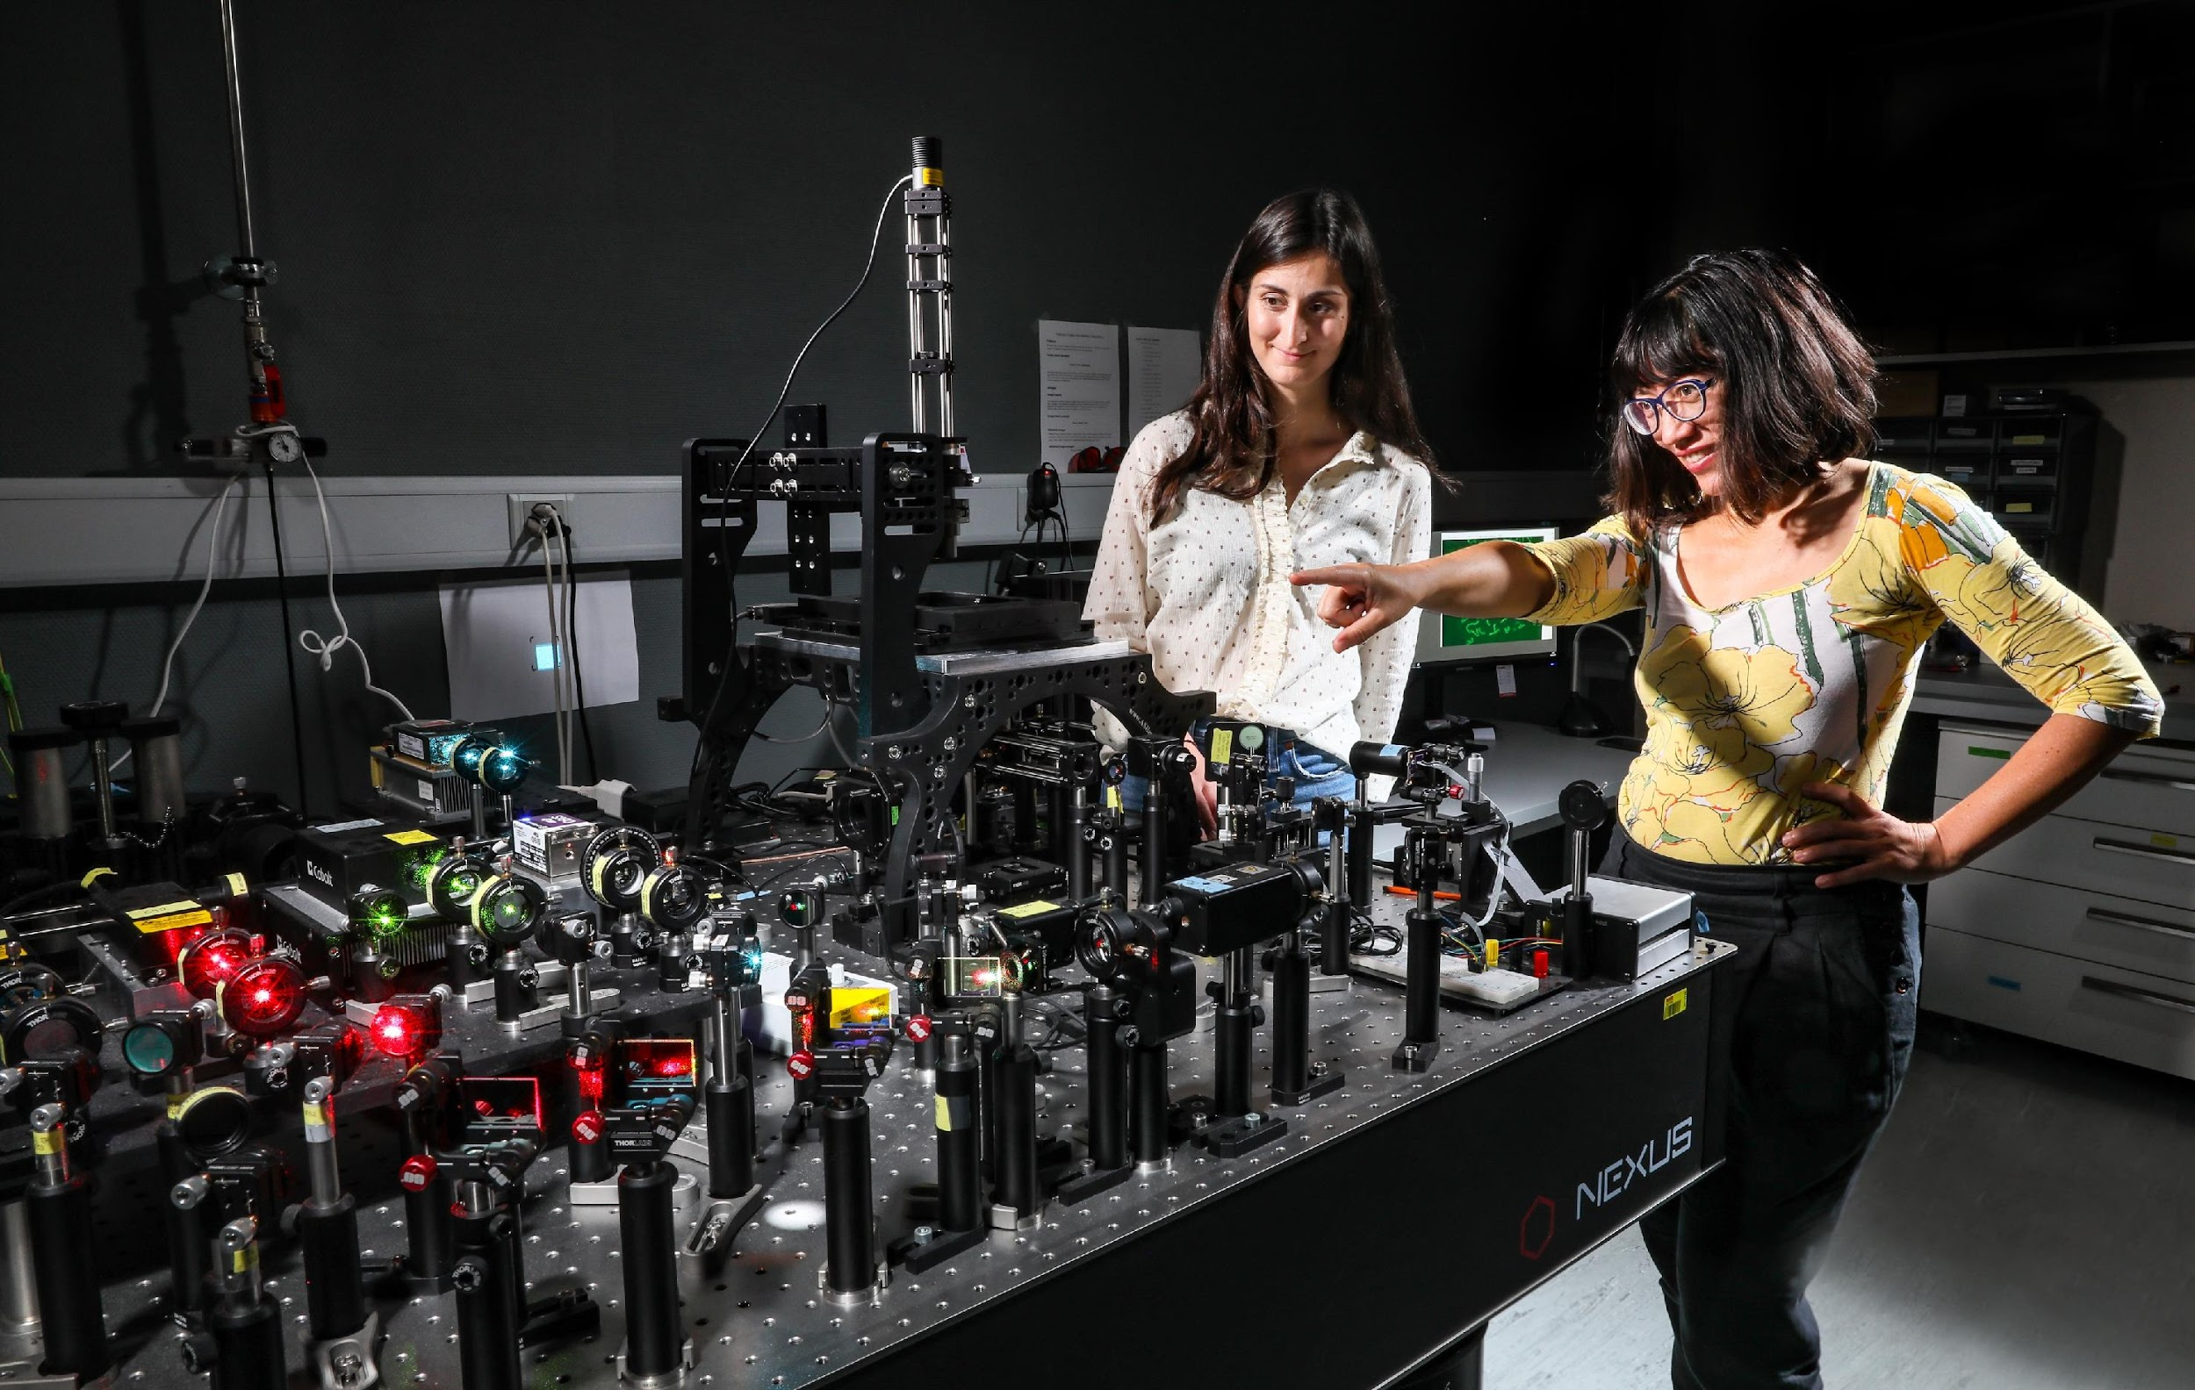
Welcome to the
Imaging Lunches!
Training in Imaging.
Once per Month.
March 5, 2025

Slide 2
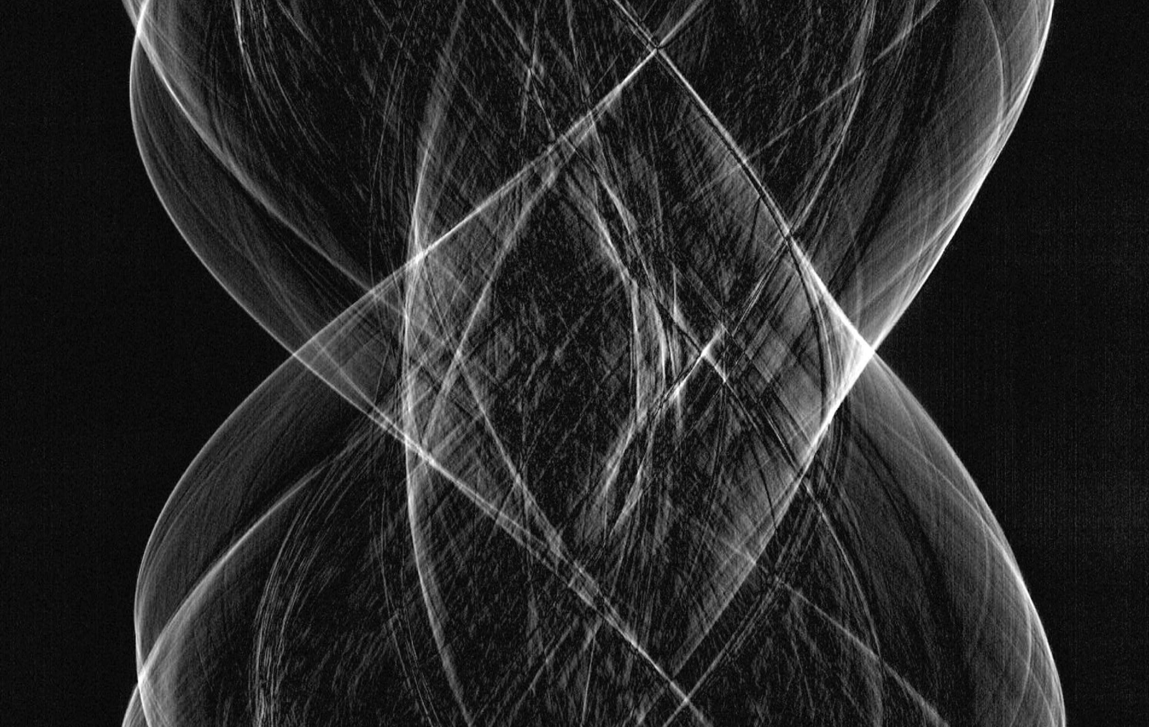

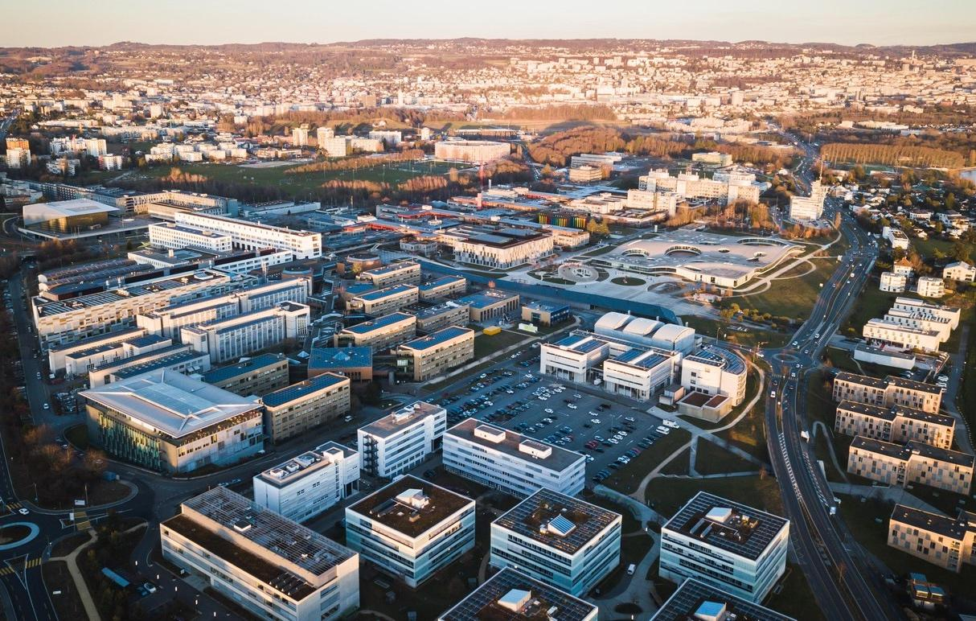
The EPFL Center for Imaging
Nurturing advanced imaging at EPFL, from the development to the use.
▪ Launched in April 2021
▪ Imaging across scales & domains
▪ Pools the expertise of 60+ labs
▪ Unique in Switzerland!
EPFL Center for Imaging

Slide 3
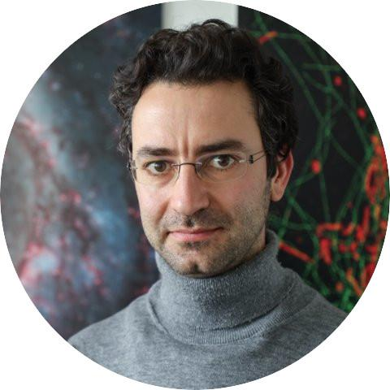
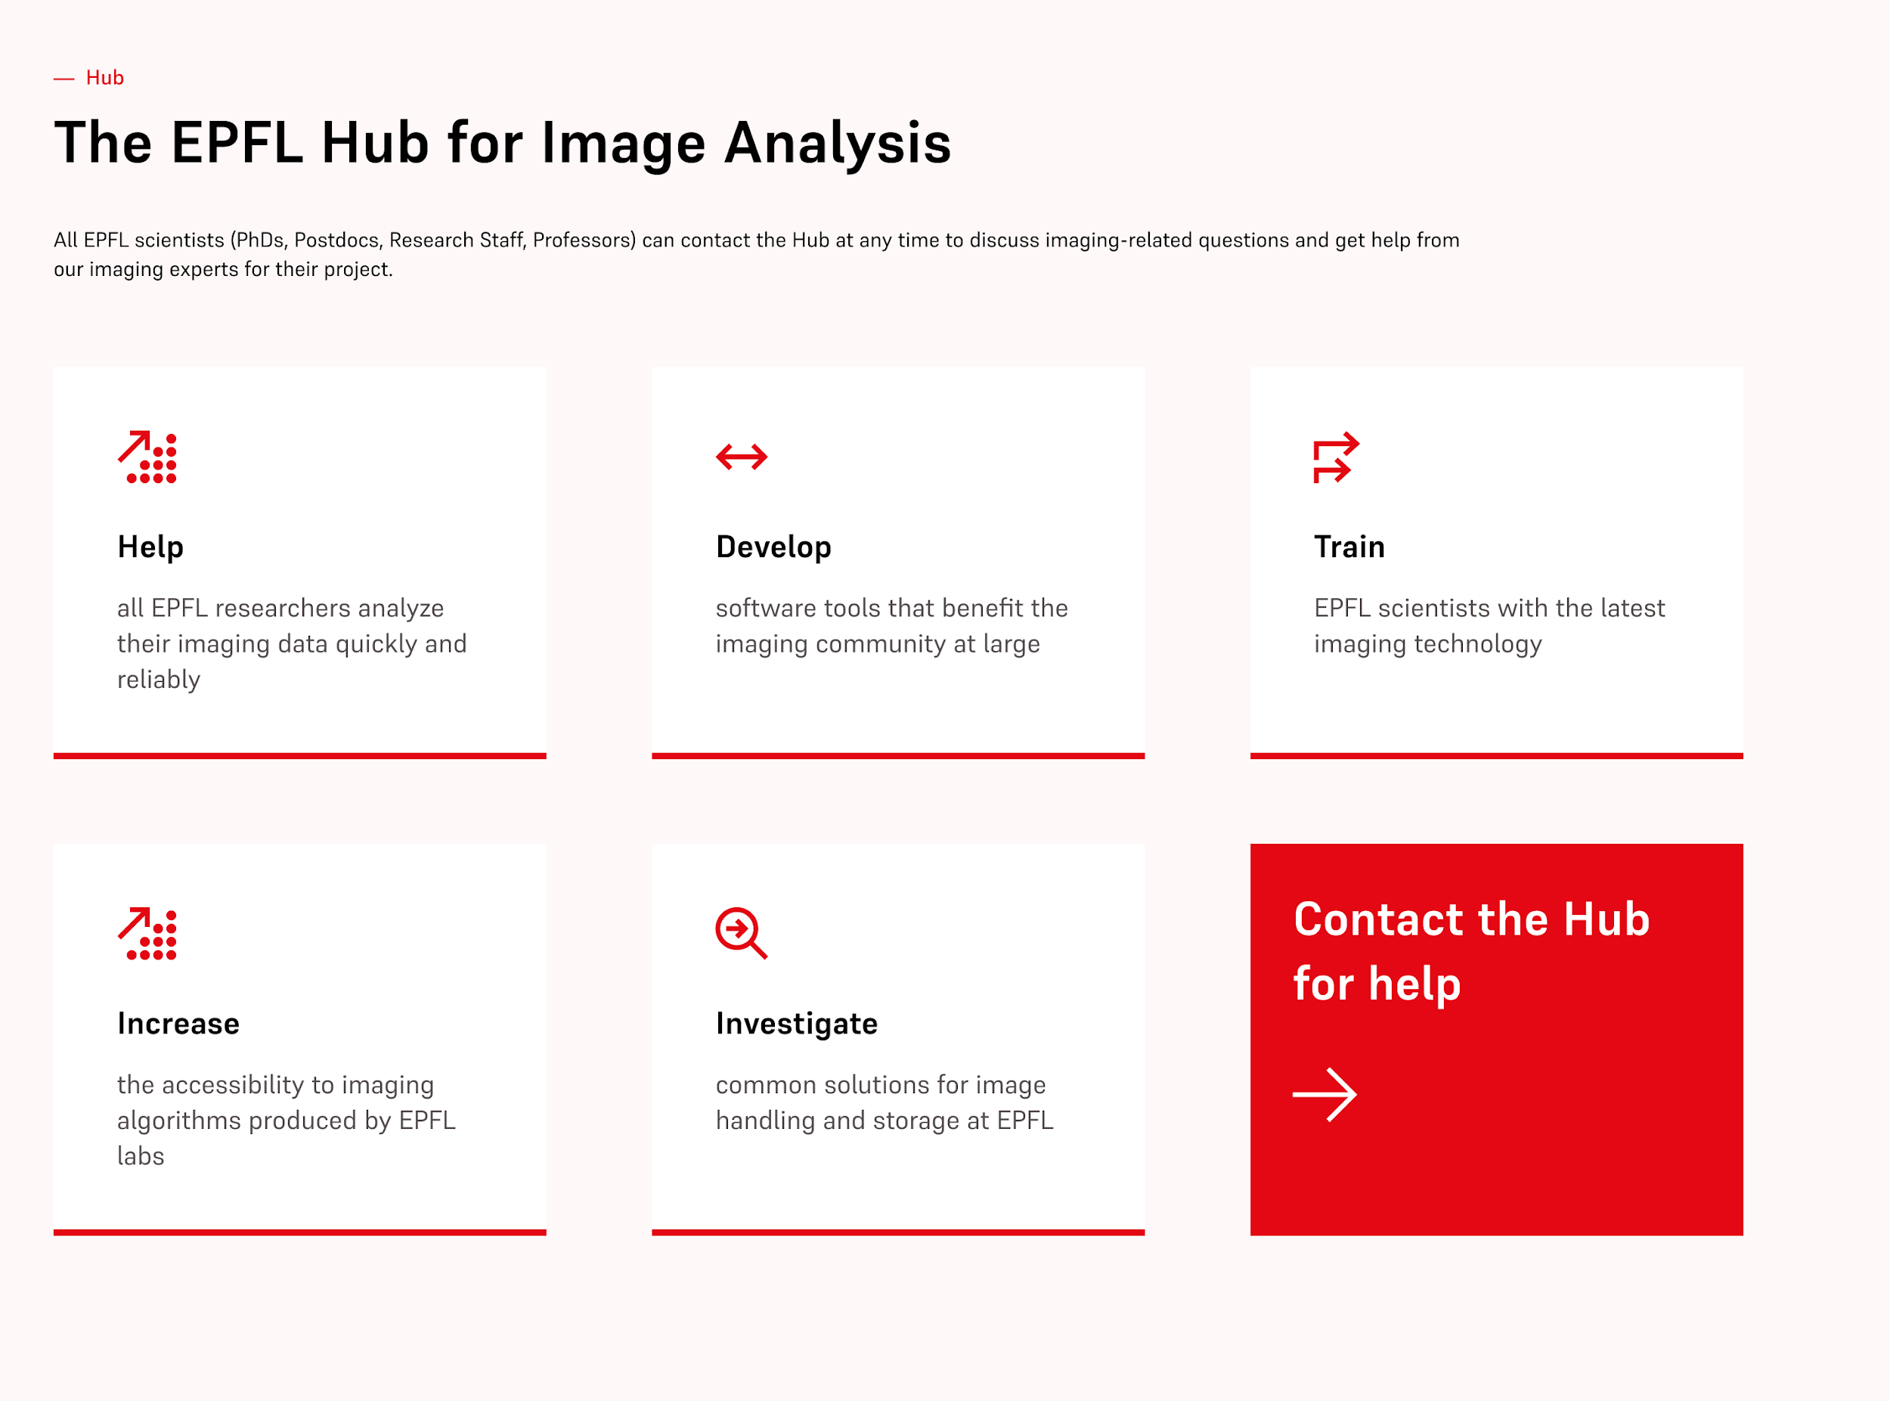
Support to all EPFL scientists!
Not sure how to start analysing your images?
Having difficulty using a software tool?
Planning an imaging experiment and wanting a second opinion?
Want to double-check if your analysis is correct and/or sufficient for publication?
EPFL Center for Imaging
Reach out to
imaging@epfl.ch!

Slide 4
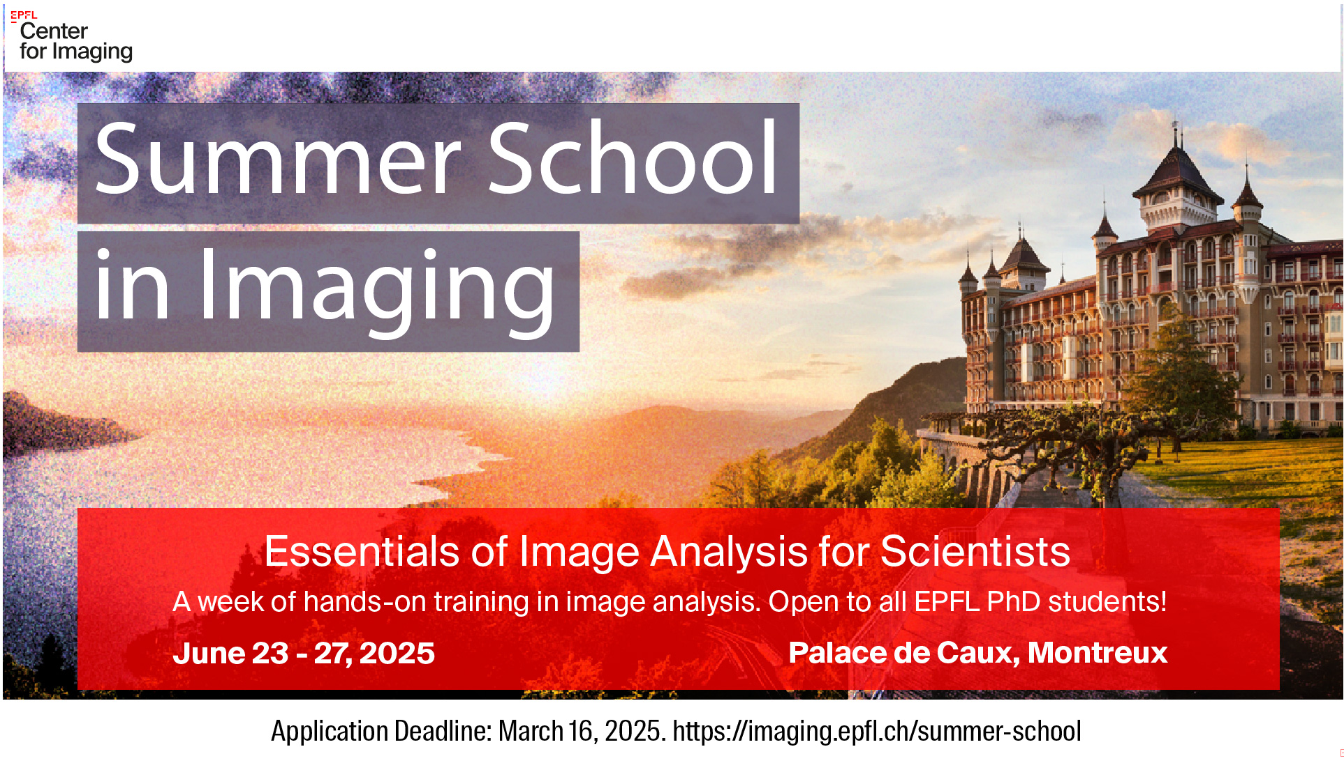

Slide 5
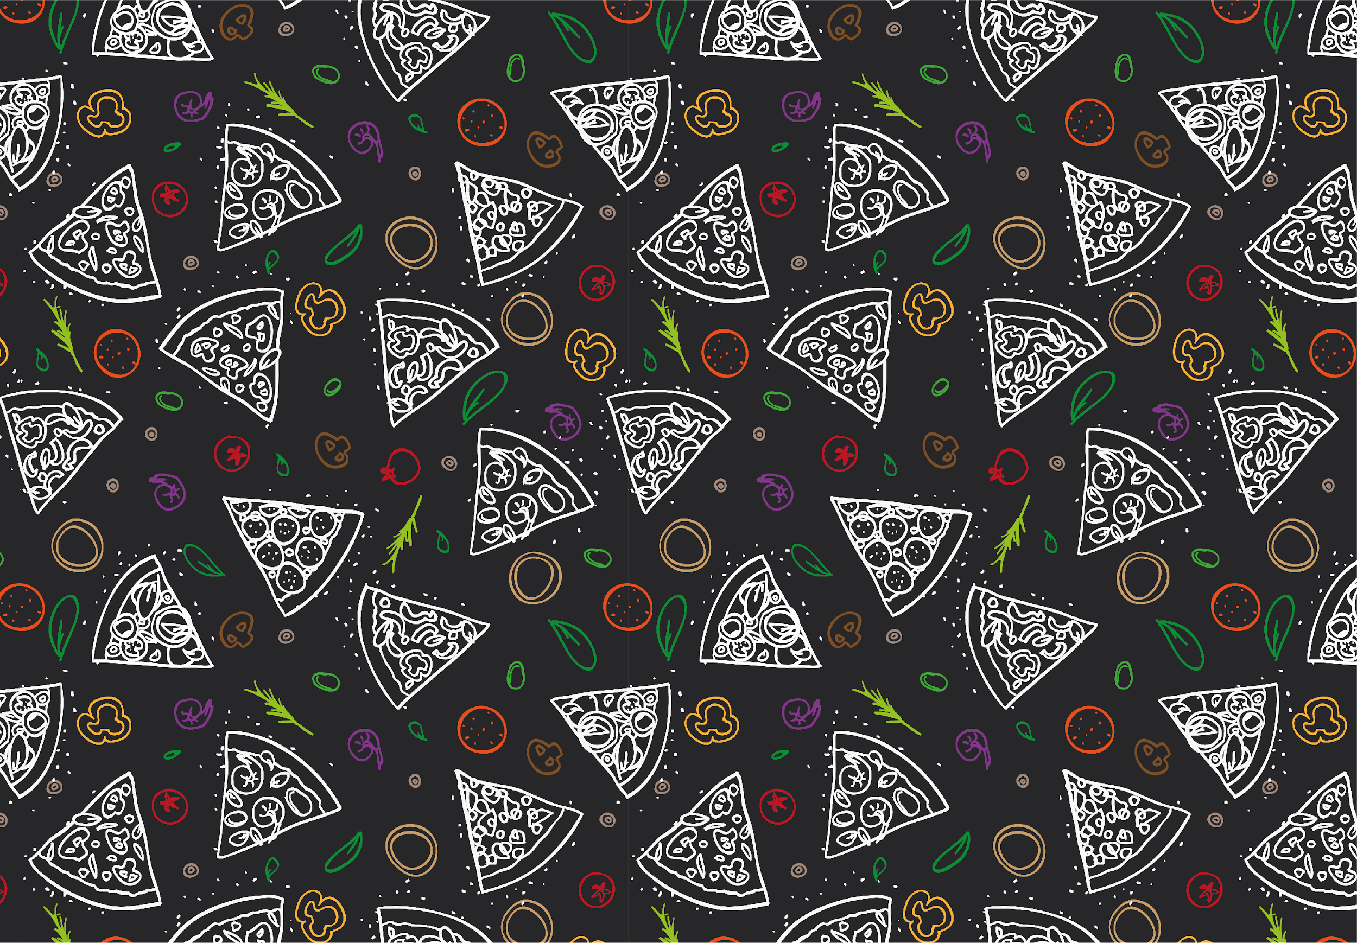
Next Imaging Lunches
March 19 nD Image Visualisation with Open-Source Tools
April 2 Image Reconstruction 101: Computational Methods & Tools
April 30 Extending Neural Networks Beyond 2D: Approaches for 3D and Temporal Data
May 14 Deconvolution: Restore Sharper Images by Inverting Acquisition
June 4 Introduction to Photogrammetric Reconstruction: Theory and Application with Meshroom

Slide 6
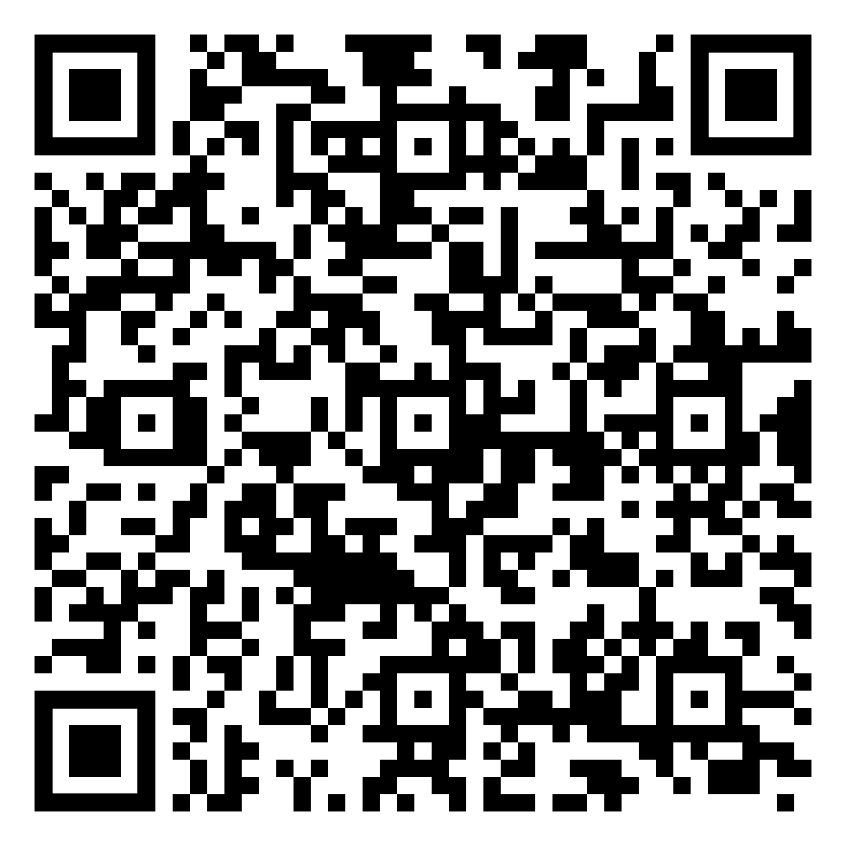
Share your feedback with us

